Slide 1
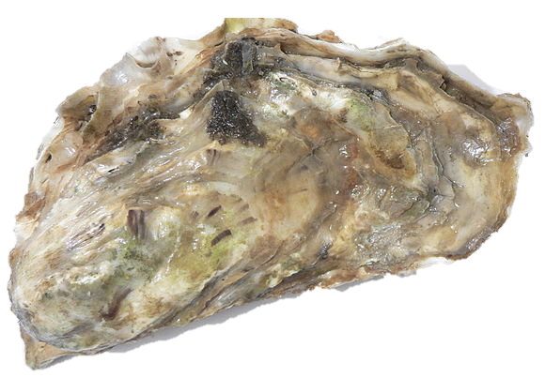

The genetic legacy of the deliberate introduction of Pacific oysters
Erik Sotka
Allan Strand
Ryan Carnegie, Jim Carlton, Lucia Couceiro, Jeff Crooks, Hikaru Endo, Hilary Heyford, Masakazu Hori, Mits Kamiya, Gen Kanaya, Judith Kochmann, Kun-Seop Lee, Lauren Lees, Hannah Miller, Massa Nakaoka, Eric Pante, Jennifer Ruesink, Evangelina Schwindt, Åsa Strand, Richard Taylor, Ryuta Terada, Martin Thiel, Takefumi Yorisue, Danielle Zacherl

Slide 2
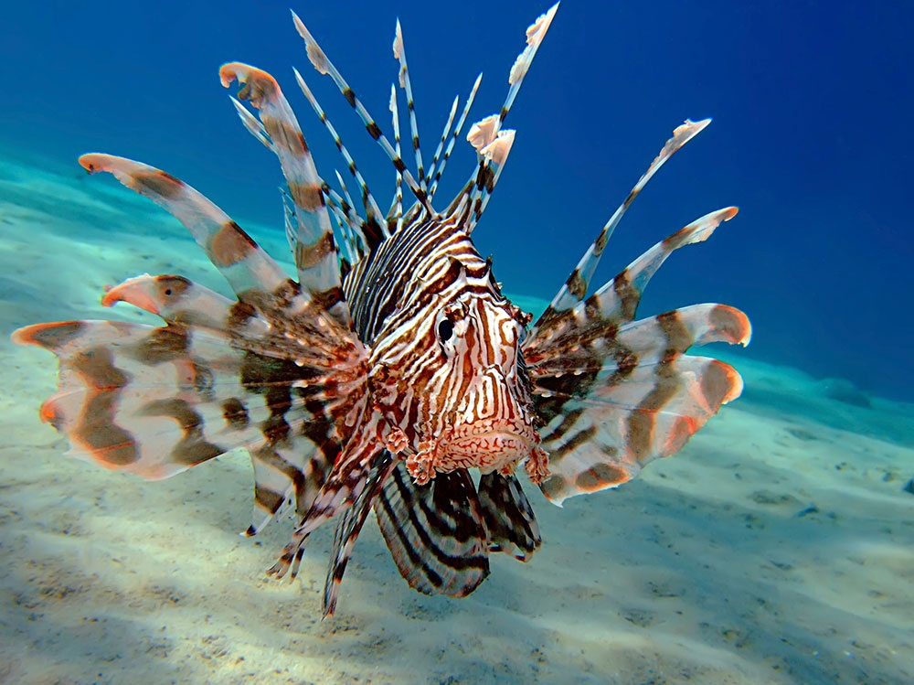
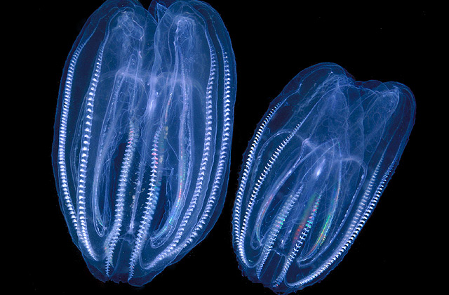
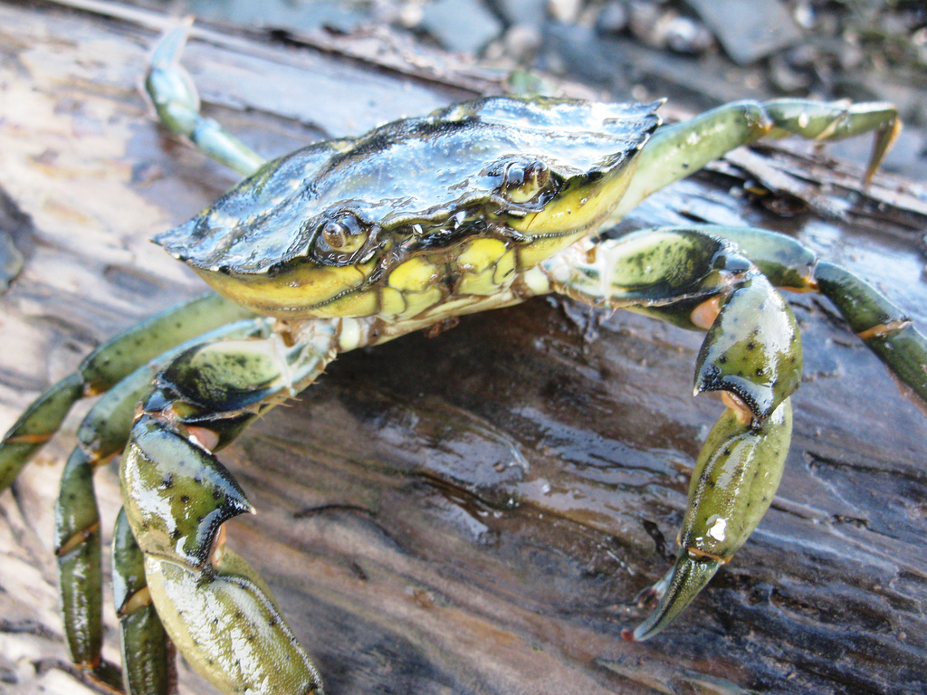
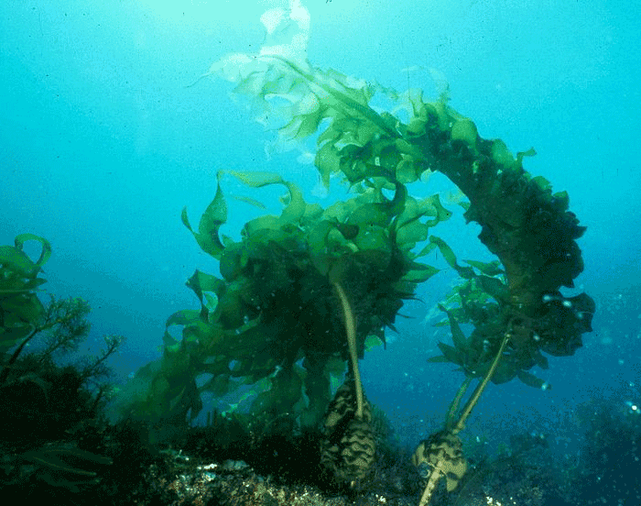
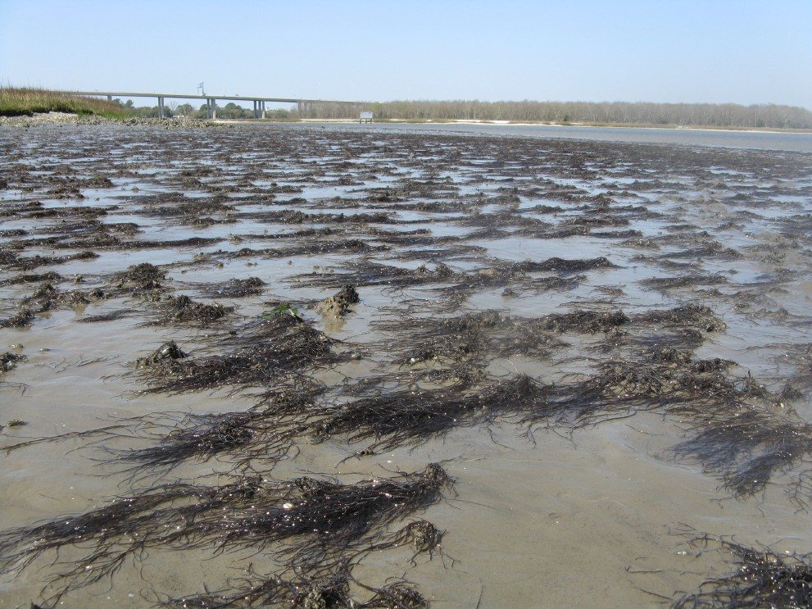
Notes:
the pace and impacts of non-native marine species continues to grow worldwide. new pools of species are now available because of accelerating pace of commerce and trade worldwide, unleashing even more species to move awayfrom their native ranges.
Lionfish
European green crab
Borea (cenophore)
Undaria, a japanese kelp.

Slide 3
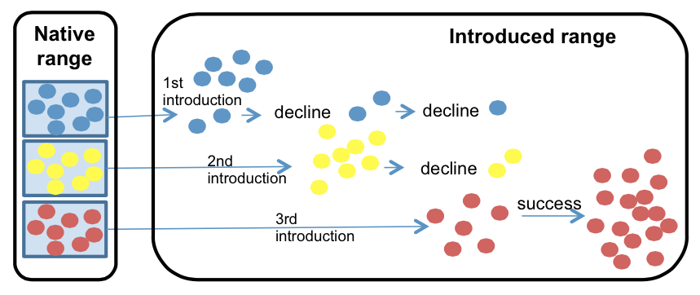
Identifying vectors and the native sources of introduced species
Prevent future invasions
Understand why a species succeeds or fails
Understand its future threat (adaptive capacity)
Rius et al. 2014 Biol. Inv.
Notes:
One important element of our understand of the invasion process is the identification of vectors and native sources of introduced species. This information can allow us to 1) prevent future invasions….

Slide 4
The greatest agency of all that spreads marine animals to new quarters of the world must be the business of oyster culture, a very ancient and world-wide craft. – Charles Elton (1958)

Slide 5
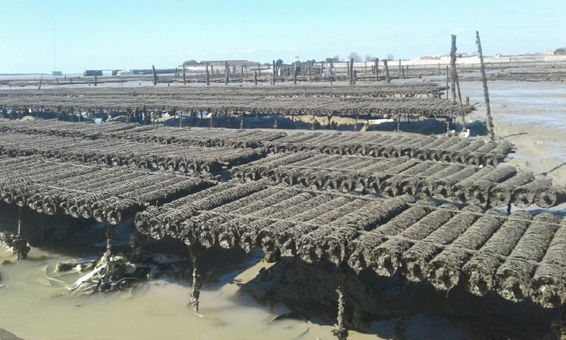
Crassostrea (Magallana) gigas Pacific cupped oyster
Among the most important aquacultural shellfish worldwide
C. gigas aquaculture
- $1.2 Billion per year
- 644,000 tons per year
Eric Pante

Slide 6
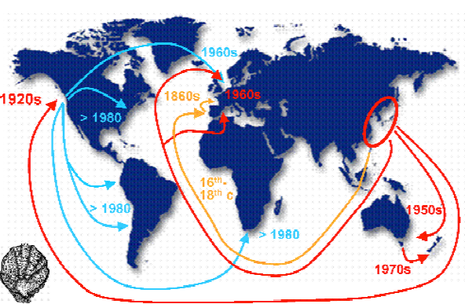
Crassostrea (Magallana) gigas Pacific cupped oyster
Among the most important aquacultural shellfish worldwide
Deliberately introduced to five continents for at least 150 years
Troost 2010

Slide 7
Crassostrea (Magallana) gigas Pacific cupped oyster
Among the most important aquacultural shellfish worldwide
Deliberately introduced to five continents for at least 150 years
An important vector for nonnative marine and estuarine species
Naylor et al., 2001, Ruiz et al. 2015, Ruesink et al. 2000

Slide 8
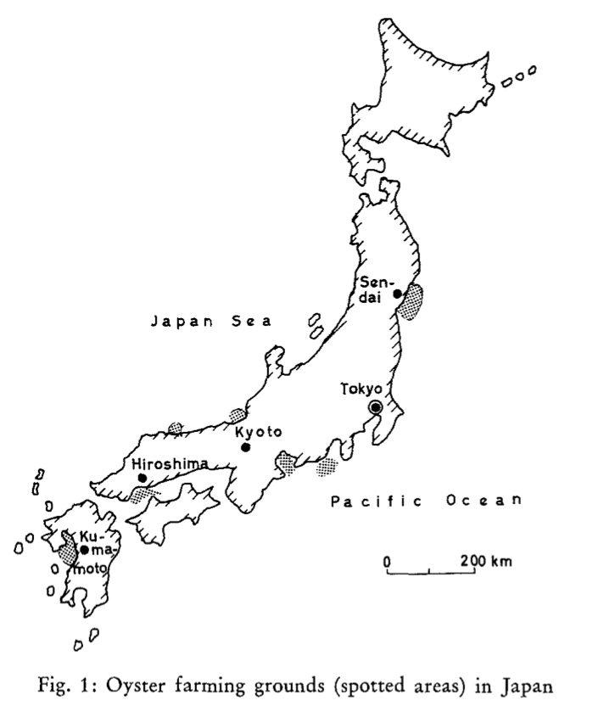
Three principal regions of industrial farming of Pacific oysters in Japan
Fuijya 1970

Slide 9
Three principal regions of industrial farming of Pacific oysters in Japan
Hokkaido
Miyagi
Hiroshima
(Seto inland Sea)
Fuijya 1970
Note: Kumamoto = C. sikamea

Slide 10
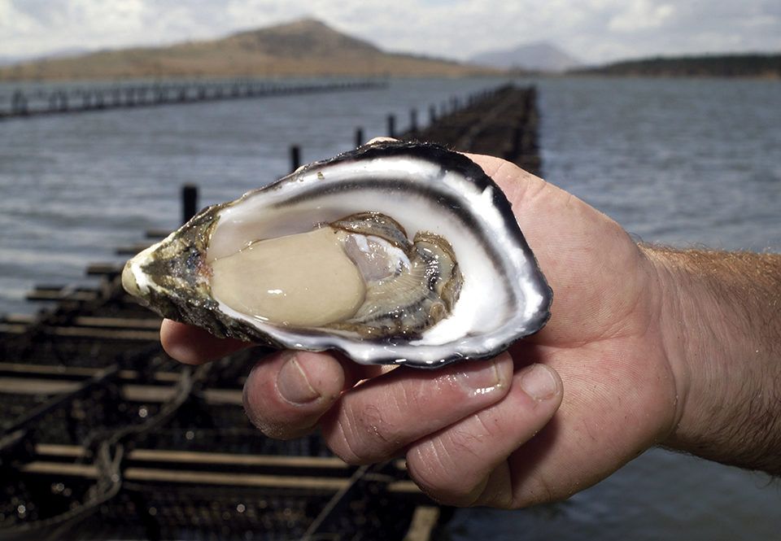
Genetic legacy of Pacific oyster introductions
Population genetic structure of native populations
The invasion history of non-native populations
Role of oyster invasions on species introductions
Bruce Miller, CSIRO

Slide 11
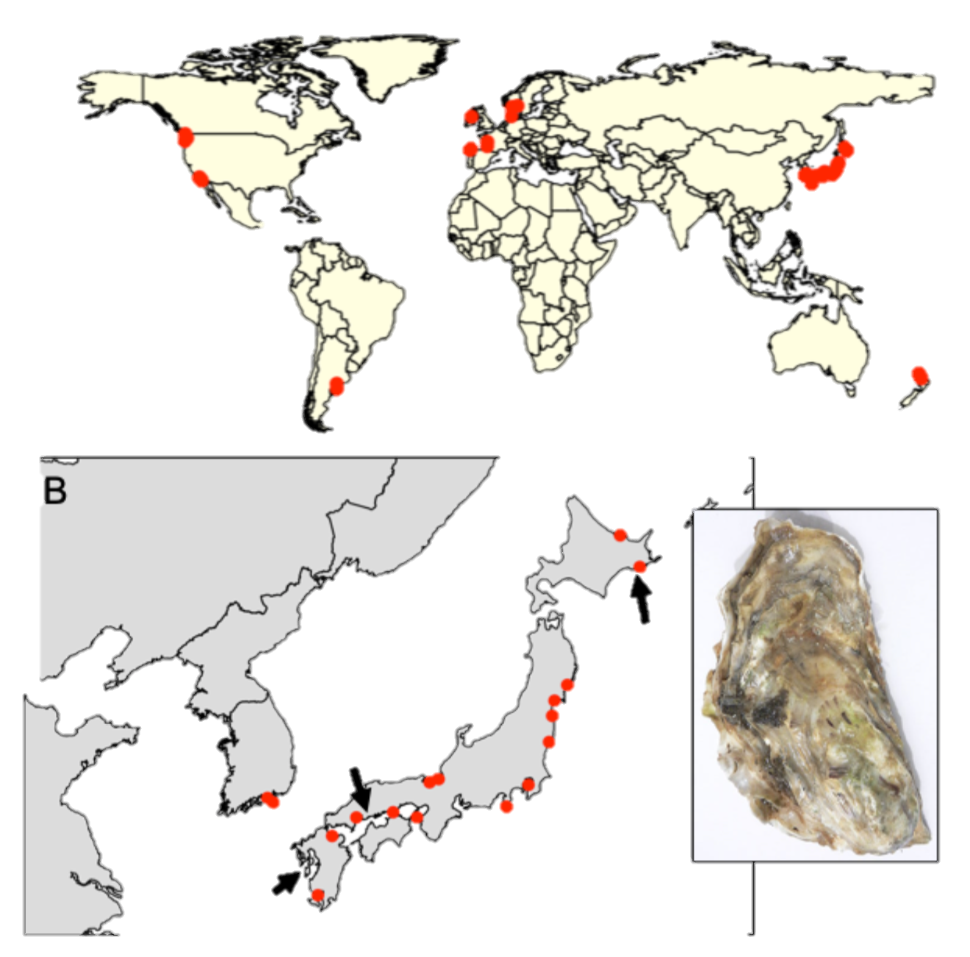
Sampling design
41 populations (n ~ 20)
20 native (Korea, Japan)
21 non-native (Europe, Western US, Chile, Argentina, NZ)
Feral populations (on rocks, jetties, reefs, etc..)
Genotype-by-sequencing
Dataset: 726 individuals and 7046 SNPs (no missing data and at HWE)
Hokkaido
Miyagi
Hiroshima
Kumamoto
Notes:
Kumamoto C. sikamea oyster

Slide 12
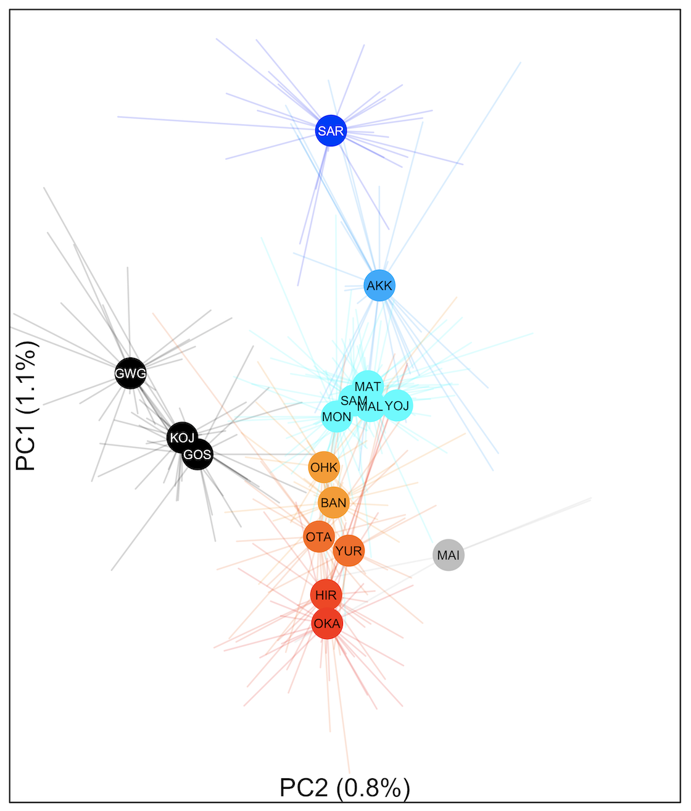
Genetic differentiation along latitude in Japan Φ_{ST} = 0 to 0.011
colors based on Genetic PC1

Slide 13
Genetic differentiation along latitude in Japan Φ_{ST} = 0 to 0.011
colors based on Genetic PC1
Hokkaido
Miyagi
Hiroshima / Seto Inland Sea
**

Slide 14
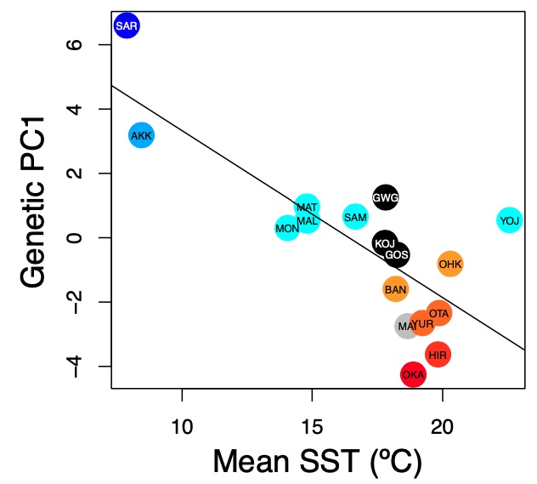
Genetic PC1 correlates with sea surface temperature (SST)
Native: r = -0.777; p< 0.001

Slide 15
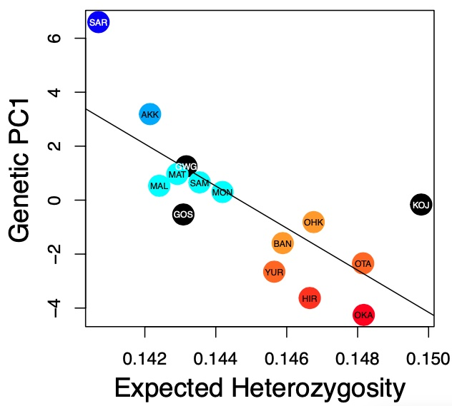
Genetic PC1 correlates with sea surface temperature (SST) and heterozygosity
Native: r = -0.777; p< 0.001
Native: r = -0.755; p = 0.001

Slide 16
Genetic legacy of Pacific oyster introductions
Population genetic structure of native populations
The invasion history of non-native populations
Role of oyster invasions on species introductions
Bruce Miller, CSIRO

Slide 17
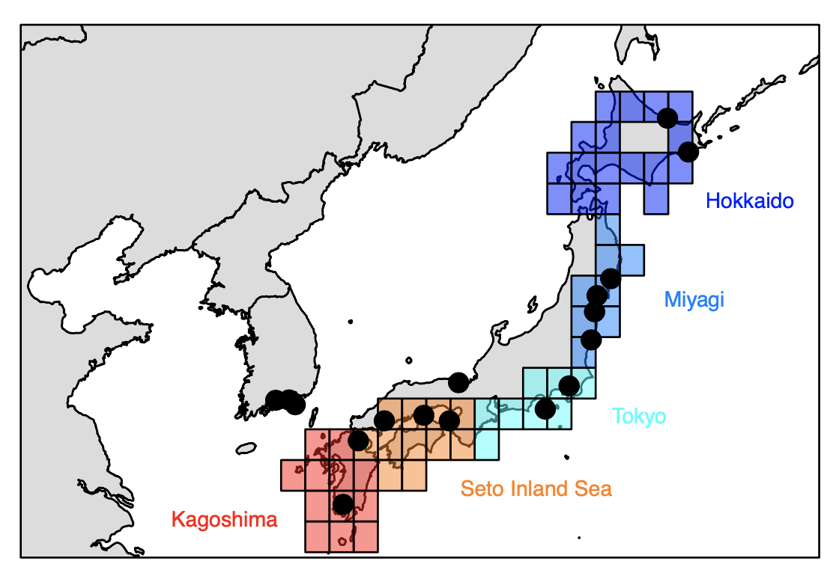
Identifying native sources via two methods
A) Use PCA trained on native individuals to assign non-native individuals
B) Machine learning (ML) to classify native regions and assign non-native individuals

Slide 18
Circlize plots summarize assignments from unsupervised machine learning (ML)

Slide 19
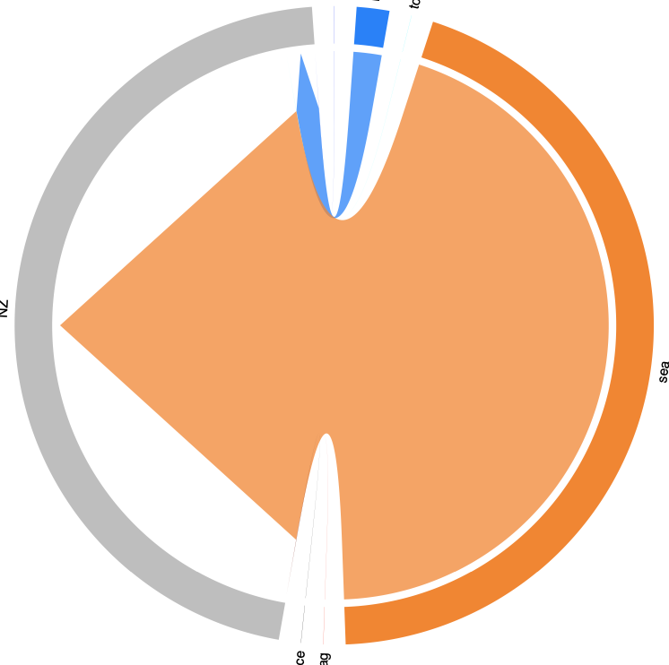
Circlize plots summarize assignments from unsupervised machine learning (ML)
Seto Inland Sea ➔ New Zealand
Miyagi
New Zealand
Seto Inland Sea
Cross validation accuracy = 70%

Slide 20
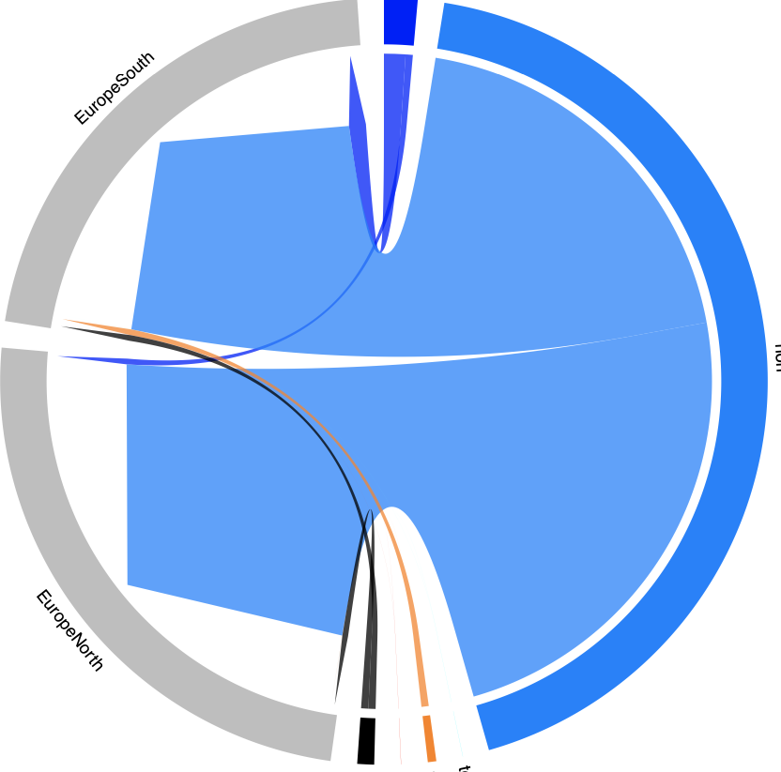
Miyagi ➔ Europe
Southern
Europe
Miyagi
Northern
Europe
Cross validation accuracy = 70%

Slide 21
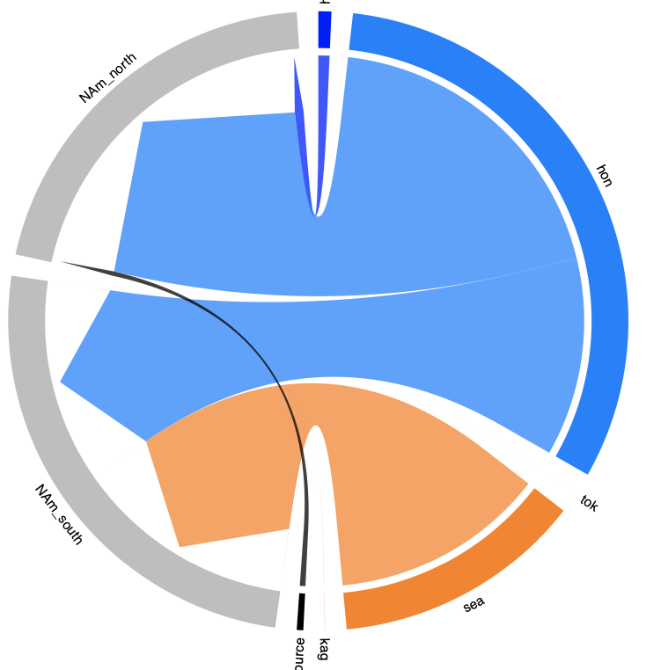
Miyagi ➔ Canada and WA State
Canada and
WA state
Miyagi
Cross validation accuracy = 70%

Slide 22
Miyagi ➔ Canada and WA State Miyagi + Seto Inland Sea ➔ Southern California
Canada and
WA state
Miyagi
California
Seto Inland
Sea
Cross validation accuracy = 70%

Slide 23
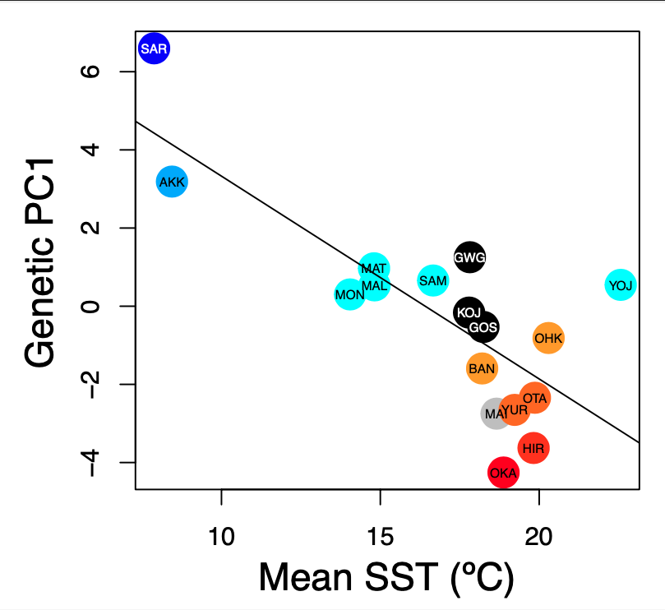
Native: r = -0.78; p< 0.001

Slide 24
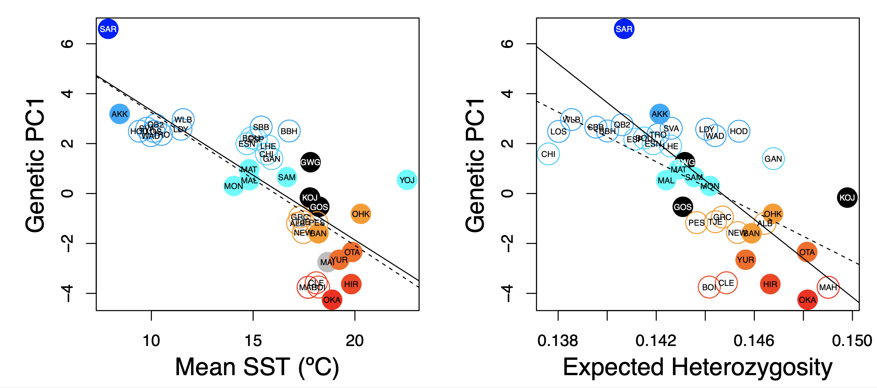
“Deliberate ecological fitting” of Pacific oysters
Native: r = -0.78; p< 0.001
Introduced: r = -0.74; p < 0.001
Ecological fitting reflects deliberate decisions by smart oyster biologists of appropriate genetic sources

Slide 25
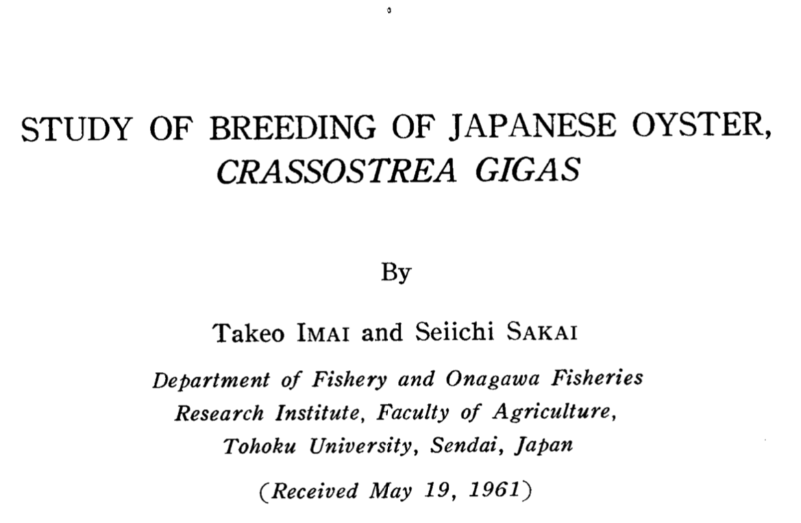
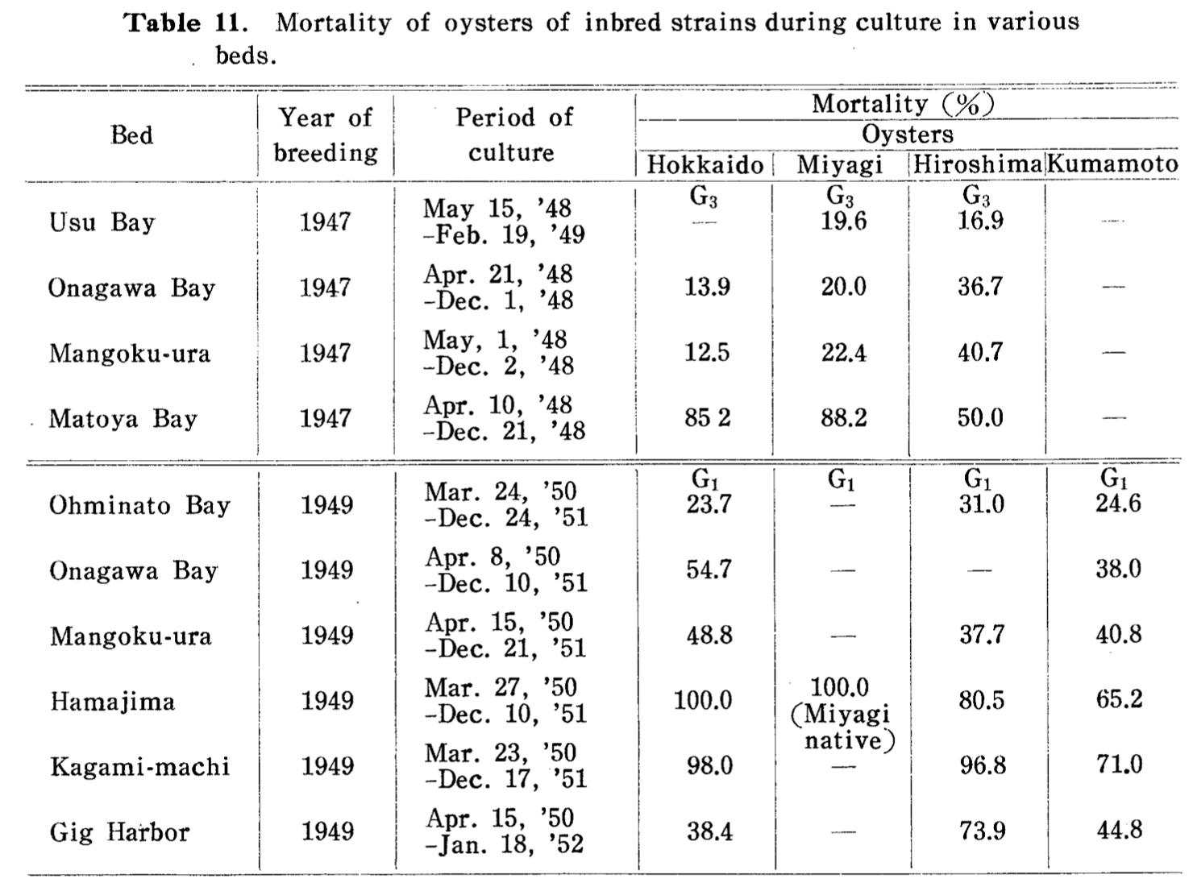
Oyster biologists identified “appropriate” genetic sources via transplant experiments
Imai and Sakai 1961
Puget Sound WA
(47ºN)
Northern Japan
(44ºN)
Southern Japan
(33ºN)

Slide 26
A genetic legacy of Pacific oyster introductions
Native: r = -0.76; p = 0.001
Introduced: r = -0.63; p < 0.001
Introduced populations maintain similar heterozygosity as their genetic source

Slide 27
Genetic legacy of Pacific oyster introductions
Population genetic structure of native populations
The invasion history of non-native populations
Role of oyster invasions on species introductions
Bruce Miller, CSIRO

Slide 28
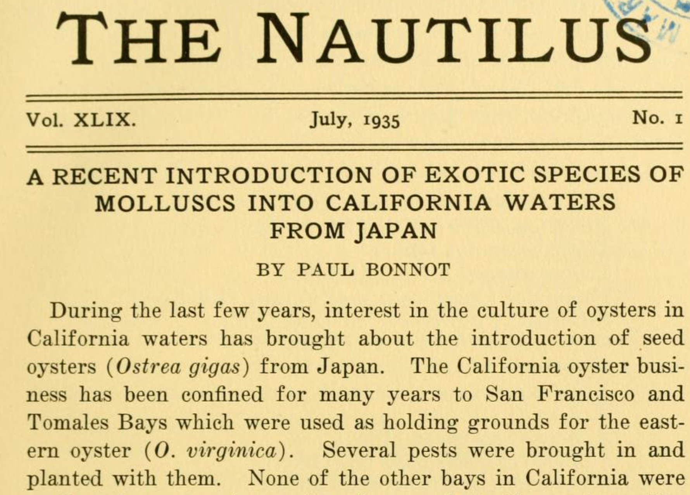
Bonnot 1935: direct observation of molluscan invaders in oyster shipments

Slide 29
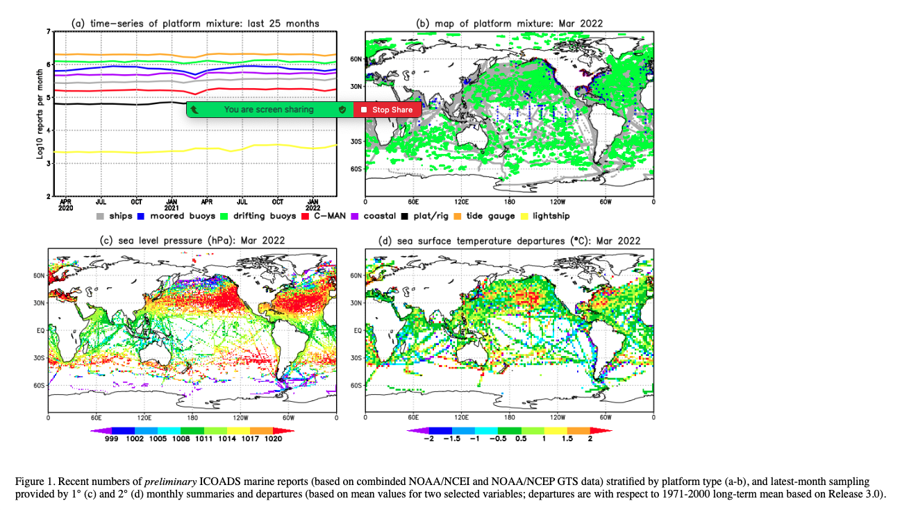
Alternative hypothesis = shipping (via fouling the hull or ballast water)
ICOADS ship log data - https://icoads.noaa.gov
1950-2010
Notes:
ICOADS ship log data – used for climate research – ship logs
Full lat-long for every trip.
Drew regions on a map on the sources / destinations. Any ship that left and arrived within 28 days.
1950-2010

Slide 30
Vector = Pacific oysters
Canada and
WA state
Miyagi
California
Seto Inland
Sea
Notes:
ICOADS ship log data – used for climate research – ship logs
Full lat-long for every trip.
Drew regions on a map on the sources / destinations. Any ship that left and arrived within 28 days.
1950-2010

Slide 31
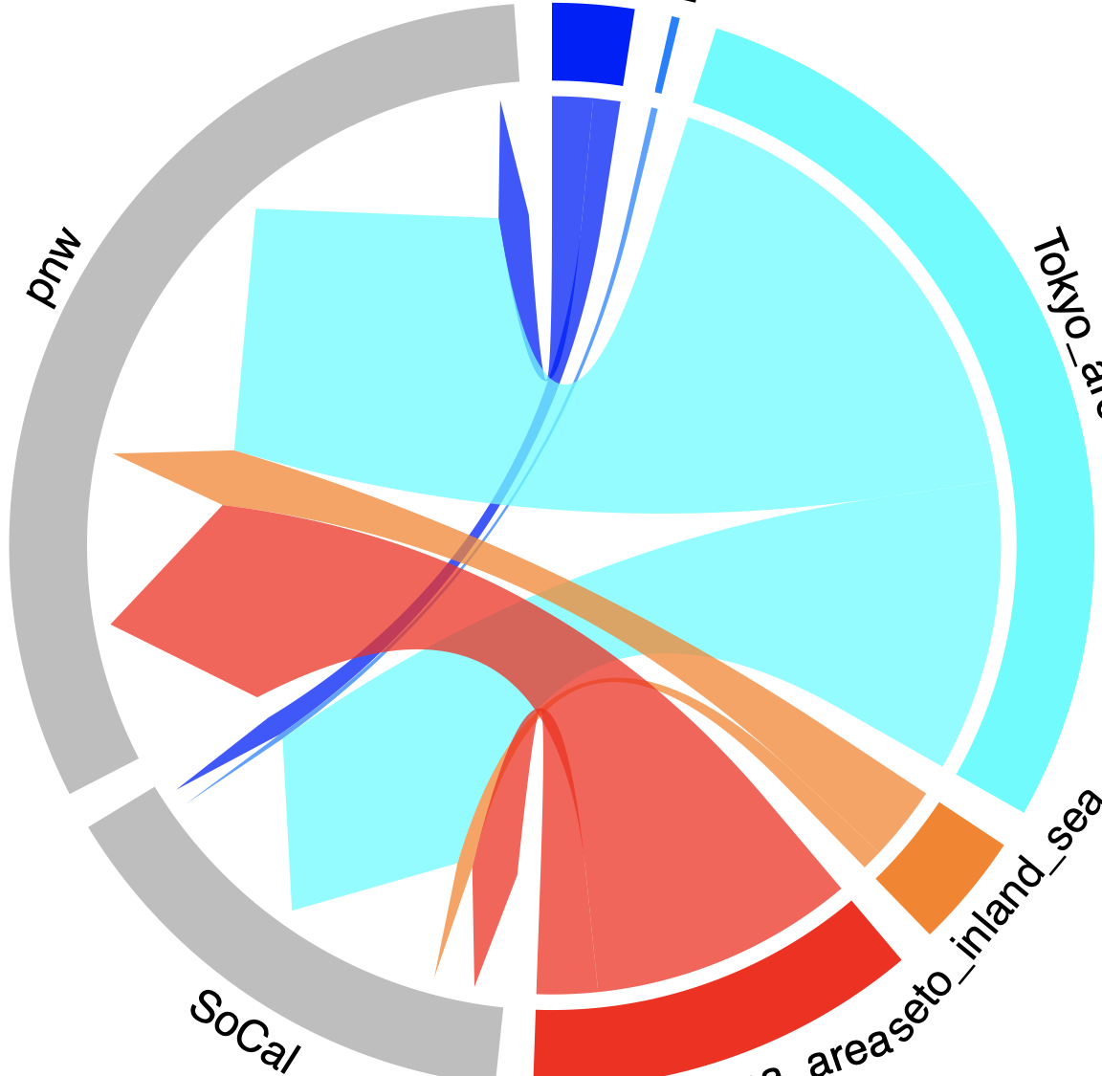
Vector = Pacific oysters
Vector = Shipping
Hokkaido
Miyagi
Canada and
WA state
Canada and
WA state
Miyagi
Tokyo
California
Seto Inland
Sea
Seto Inland
Sea
California
Kagoshima
Notes:
ICOADS ship log data – used for climate research – ship logs
Full lat-long for every trip.
Drew regions on a map on the sources / destinations. Any ship that left and arrived within 28 days.
1950-2010

Slide 32
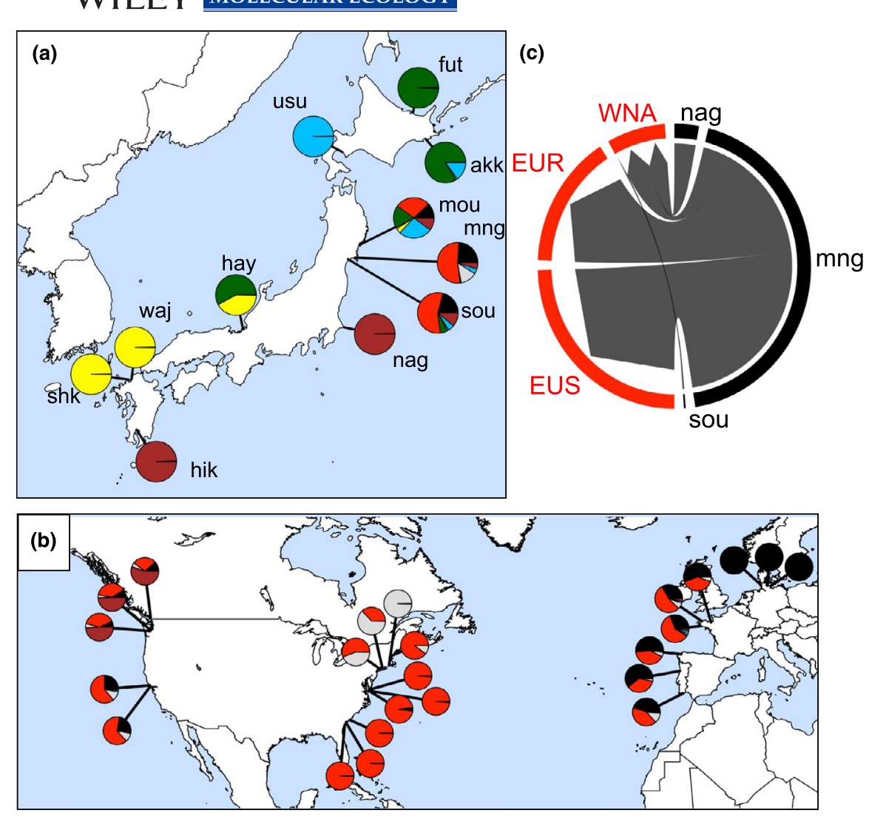
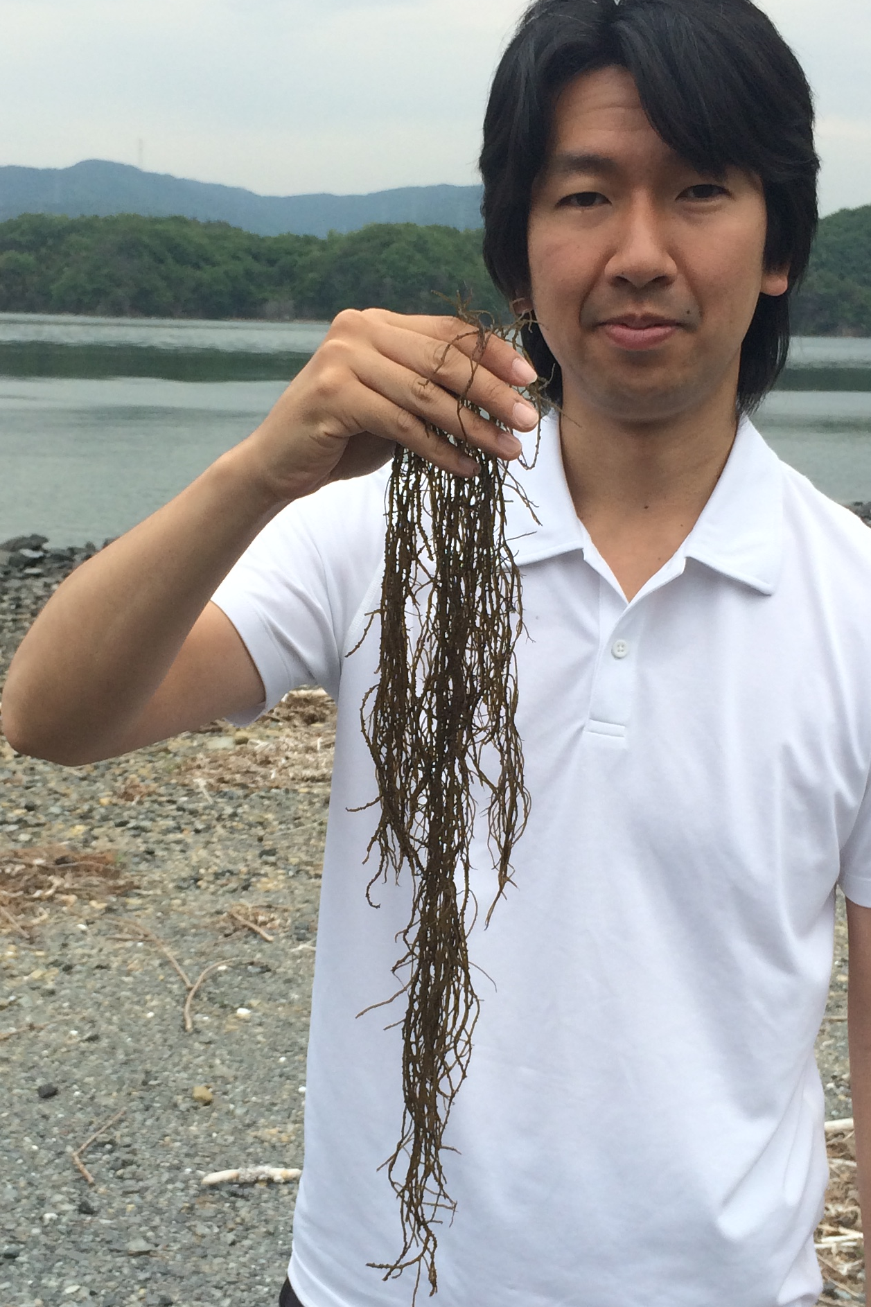
Source of Gracilaria vermiculophylla is Miyagi Japan
62,285 SNPs at 351 unique genets
- Flanagan et al 2021 Molecular Ecology

Slide 33
Source of Gracilaria vermiculophylla is Miyagi Japan
Miyagi
62,285 SNPs at 351 unique genets
- Flanagan et al 2021 Molecular Ecology

Slide 34
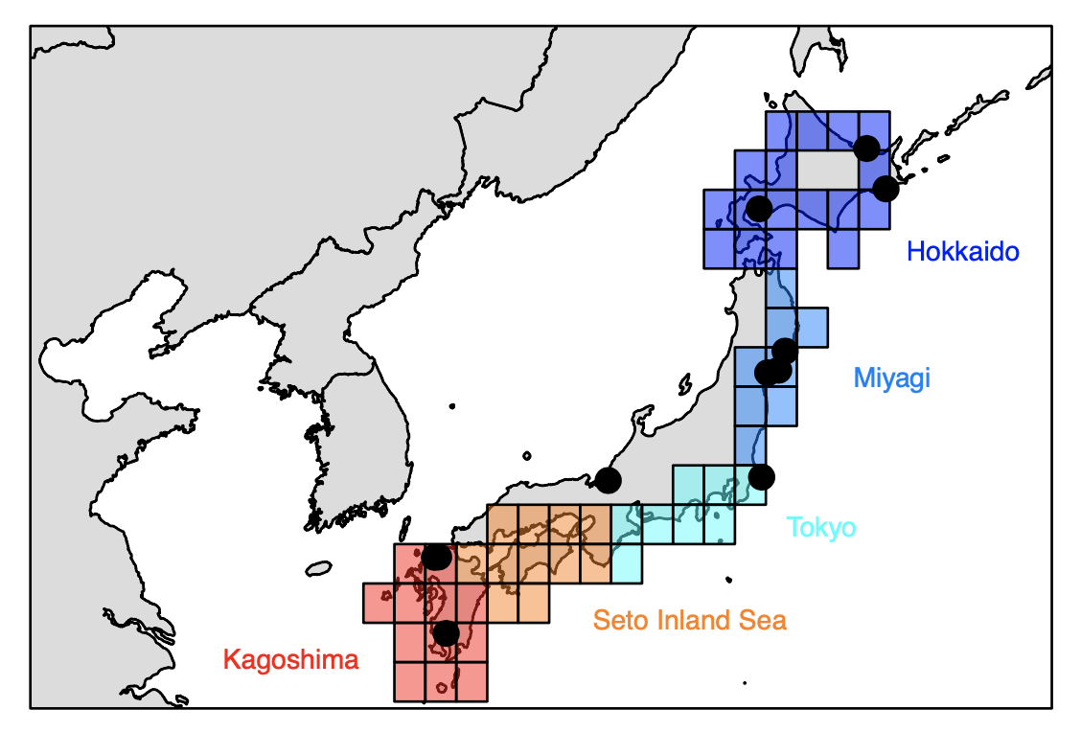
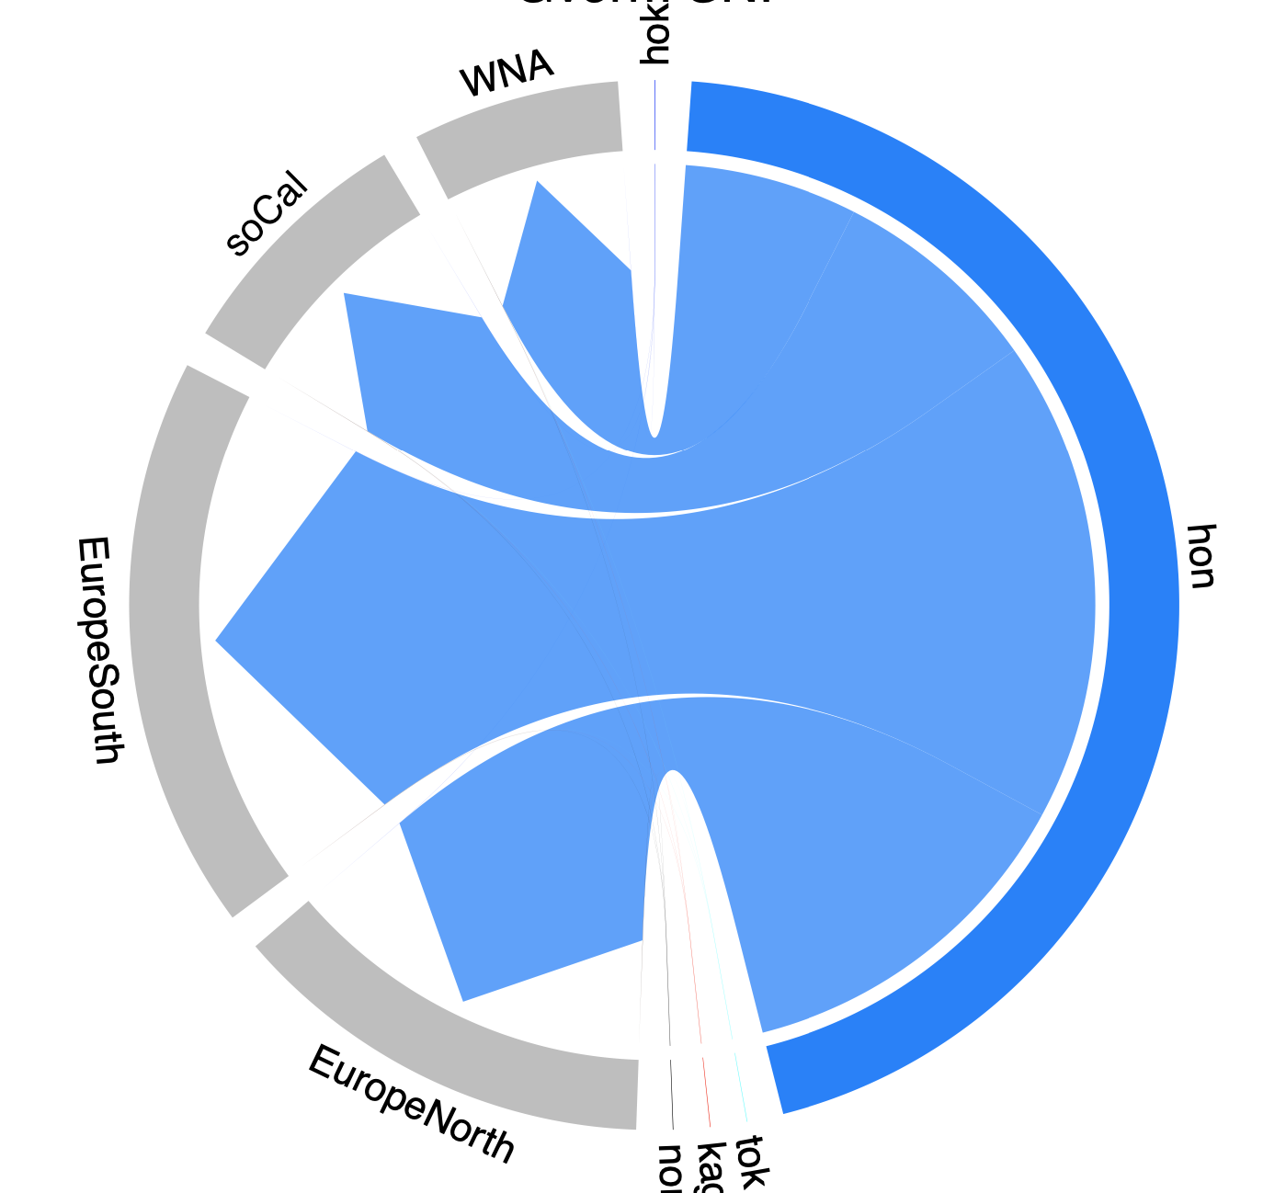
Source of Gracilaria vermiculophylla is Miyagi Japan
Canada
WA
California
Miyagi
Southern
Europe
Northern
Europe
Cross validation accuracy = 100%

Slide 35
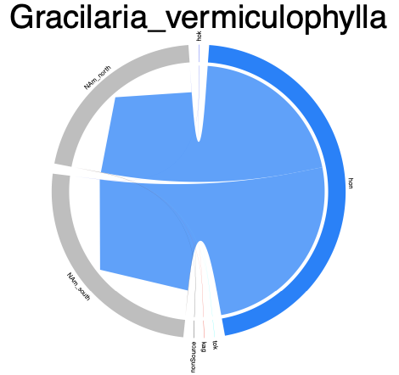
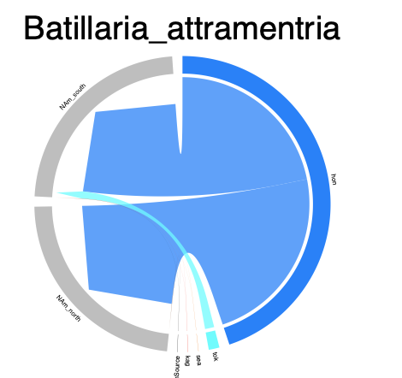
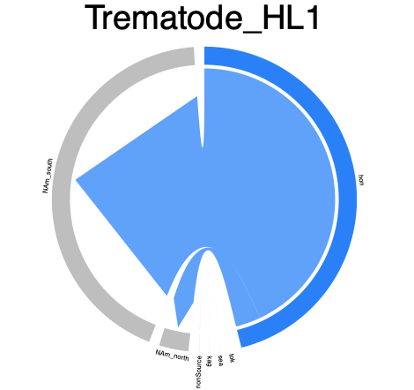
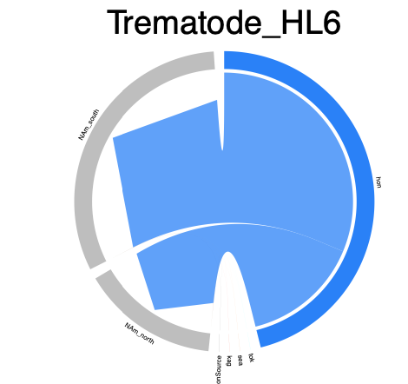
Miyagi

Slide 36
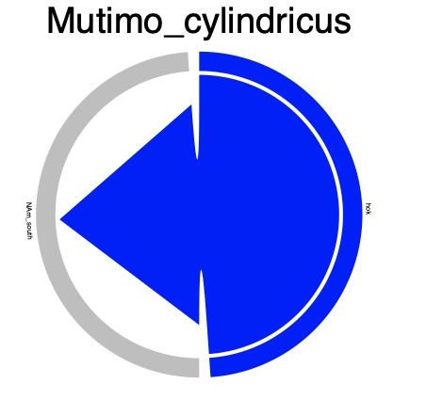
Hokkaido
Miyagi

Slide 37
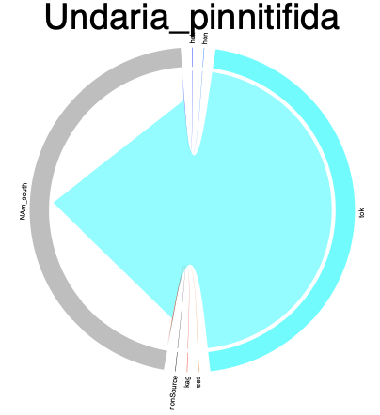
Hokkaido
Miyagi
Tokyo
More introduced species are forthcoming!

Slide 38
Conclusions
There is weak (Φ_{ST} < 1%) but significant genetic differentiation in the native range
Transport of locally-adapted genetic stocks by oyster biologists yielded “deliberate” ecological fitting in the non-native range.
Population genetics of Pacific oysters predicts that of some invaders to western North America

Slide 39
Conclusions
There is weak (Φ_{ST} < 1%) but significant genetic differentiation in the native range
Transport of locally-adapted genetic stocks by oyster biologists yielded “deliberate” ecological fitting in the non-native range.
Population genetics of Pacific oysters predicts that of some invaders to western North America

Slide 40
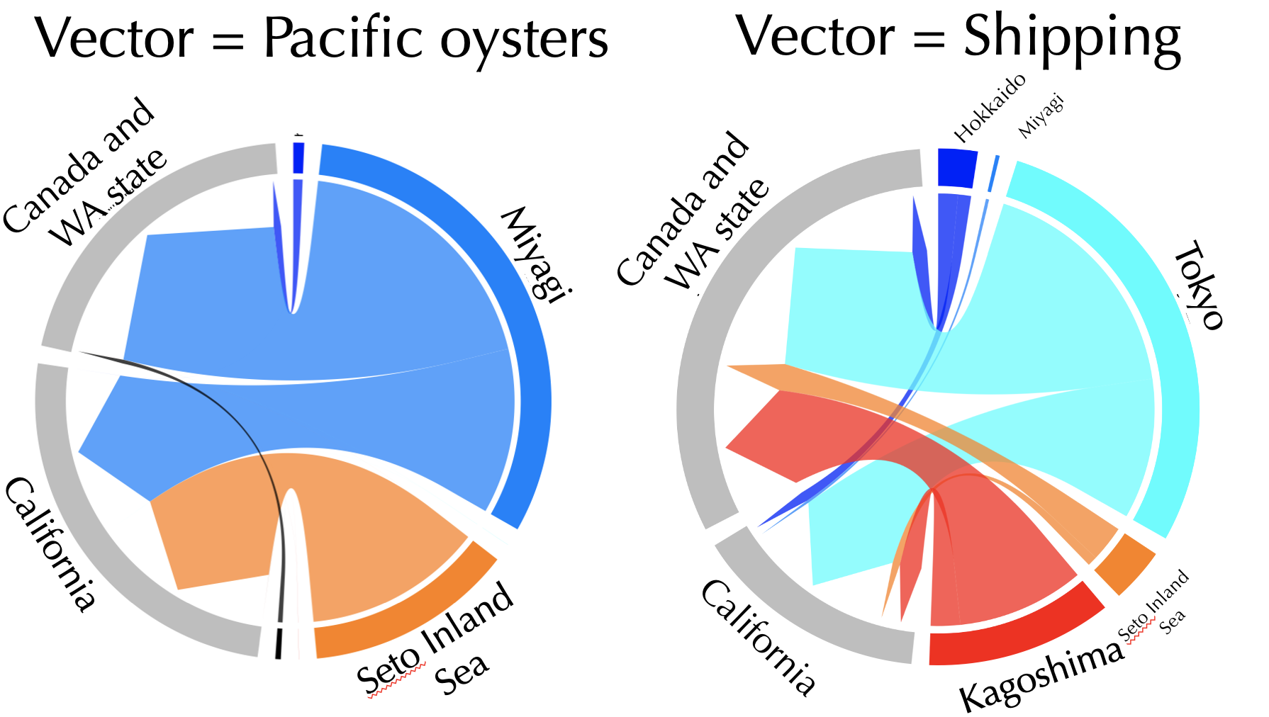
Conclusions
There is weak (Φ_{ST} < 1%) but significant genetic differentiation in the native range
Transport of locally-adapted genetic stocks by oyster biologists yielded “deliberate” ecological fitting in the non-native range.
Population genetics of Pacific oysters provide a mechanism to delineate vectors (i.e., oysters vs shipping)

Slide 41

Acknowledgements
Argentina | Evangelina Schwindt
Chile | Martin Thiel, Jim Carlton
Denmark | Asa Strand
France | Eric Pante
Ireland | Asa Strand, Judith Kochmann
Japan | Takefumi Yorisue, Masahiro Nakaoka, Mits Kanaya, Masahiro Hori, Gen Kanaya, Ryuta Terada, Hikaru Endo
Korea | Kun-Seop Lee
New Zealand | Richard Taylor
Norway | Asa Strand
USA | Jennifer Ruesink, Hilary Heyford, Danielle Zacherl, Jeff Crooks
Spain | Lucia Couceiro
Sweden | Asa Strand, Judith Kochmann
OCE-1924599
Also Lauren Lees, Hannah Rothkopf, Hannah Miller, Dallas Crowder, Ryan Carnegie, Osamu Miura

Slide 43
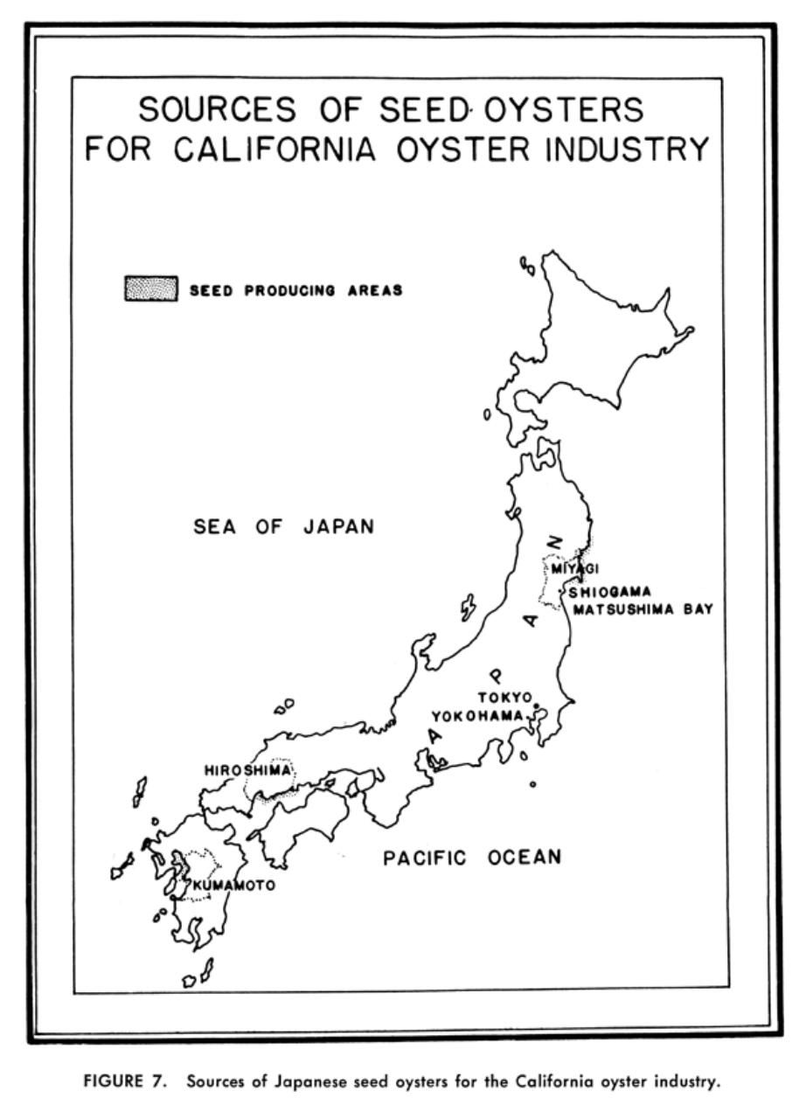
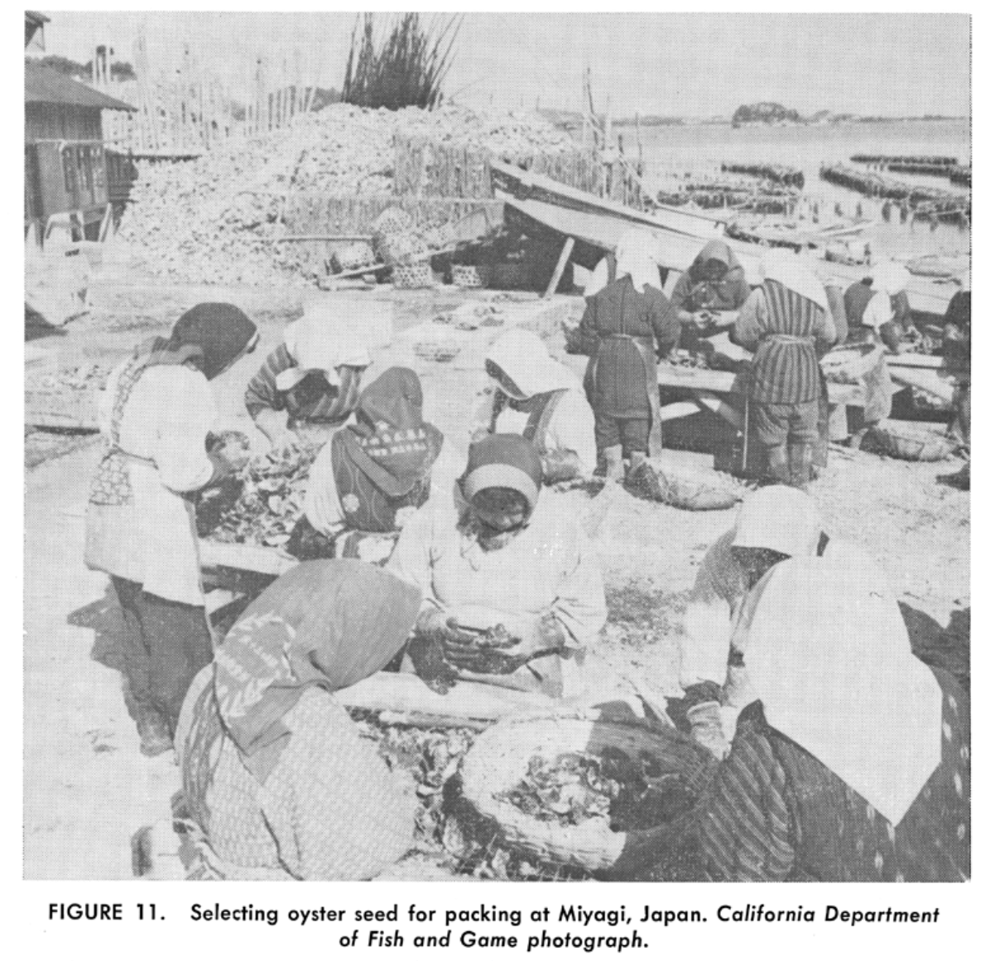
Barrett 1963

Slide 44
ICOADS ship log data - https://icoads.noaa.gov
Notes:
ICOADS ship log data – used for climate research – ship logs
Full lat-long for every trip.
Drew regions on a map on the sources / destinations. Any ship that left and arrived within 28 days.
1950-2010

Slide 45
Seto Inland Sea ➔ New Zealand
colors based on Genetic PC1

Slide 46
Miyagi ➔ Europe and S. America
colors based on Genetic PC1

Slide 47
Southern California are intermediate between Seto Inland Sea and Miyagi (as is Tokyo)
colors based on Genetic PC1

Slide 48
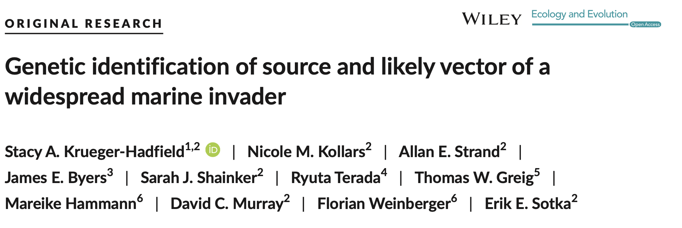
“Because this area historically served as the principal source for oyster exports worldwide, we suggest that oysters were the key vector for the G. vermiculophylla invasion.”
All in all, there is not conclusive evidence in the manuscript to convince the reader about the role of C. gigas as a vector beside the coincidental presence in the northern hemisphere. A comparison between the genetic structure of the vector and of the alga could have been attempted.

Slide 49
Bonnot (1935) documented the occurrence of invasive mollusks with imported Japanese oyster shipments to North American estuaries.
From ad hoc reviewers of K-H 2017 at Mol Ecol
Furthermore, their claims to identify the vector (C. gigas) remains purely speculative - this would be confirmed by congruent patterns of genetic diversity of both C. gigas and G. vermiculophylla in their native and introduced ranges.
"... our results support anecdotal evidence that oysters were the key vector for the G. vermiculophylla invasion." Congruent patterns of genetic diversity across the two species would have clarified this - as it is, there is only "arm-waving".
All in all, there is not conclusive evidence in the manuscript to convince the reader about the role of C. gigas as a vector beside the coincidental presence in the northern hemisphere. A comparison between the genetic structure of the vector and of the alga could have been attempted.
“Because this area historically served as the principal source for oyster exports worldwide, we suggest that oysters were the key vector for the G. vermiculophylla invasion. “ Krueger-Hadfield et al 2017 Ecology and Evolution
“The source region historically provided seed oysters (Crassostrea gigas) for aquaculture in North America” Miura et al. 2001 PNAS

Slide 50
The greatest agency of all that spreads marine animals to new quarters of the world must be the business of oyster culture, a very ancient and world-wide craft. – Charles Elton (1958)

Slide 51
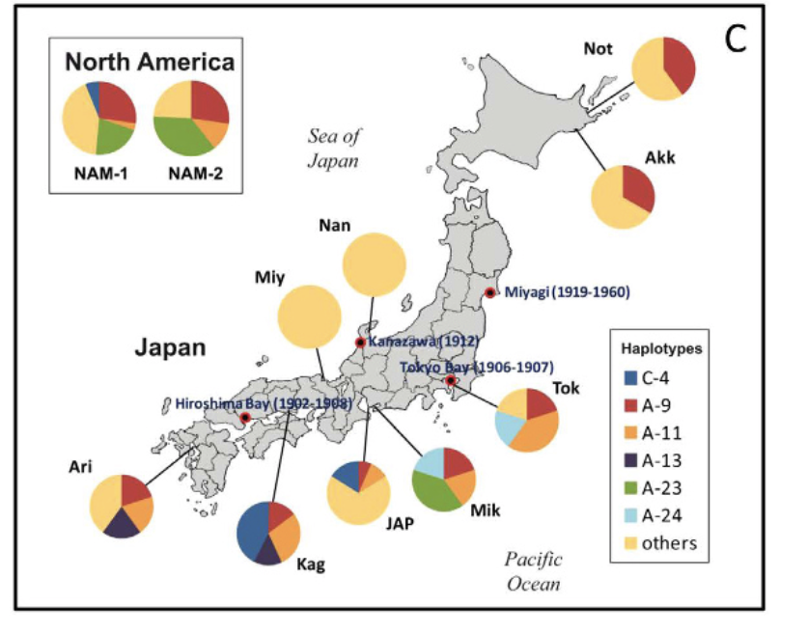
Notes:
Ruditapes

Slide 52
Battillaria attramentaria
Miura et al. 2005 PNAS

Slide 53
Genetic differentiation along latitude in Japan Φ_{ST} = 0 to 0.011
Hokkaido
Miyagi
Hiroshima

Slide 54
Pacific oysters from Europe and Canada, Washington state came from northern Japan
Circlize plots; Machine learning

Slide 55
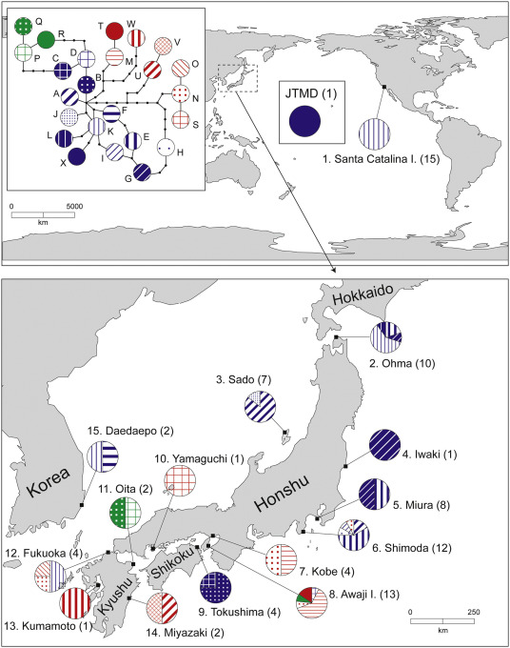

Slide 56
Pacific oysters from southern California are a mix of northern and southern Japan
Pacific oysters from New Zealand came from southern Japan
Circlize plots; Machine learning

Slide 57
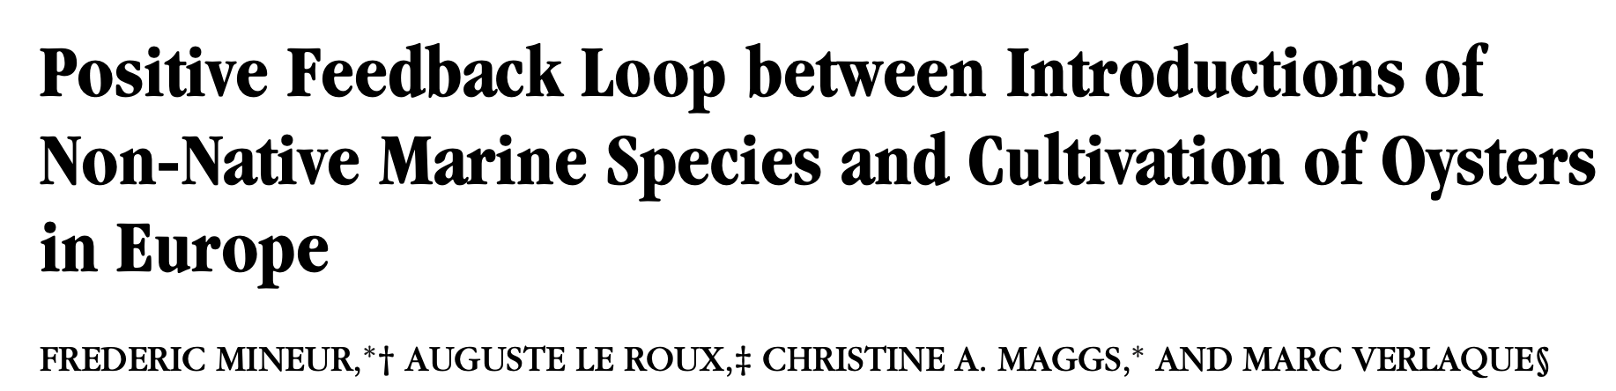
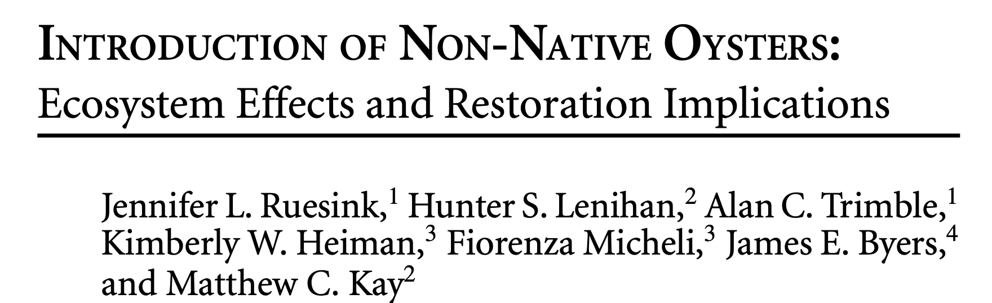
Problem: Without direct observations, we have largely indirect evidence for oyster as a vector

Slide 58
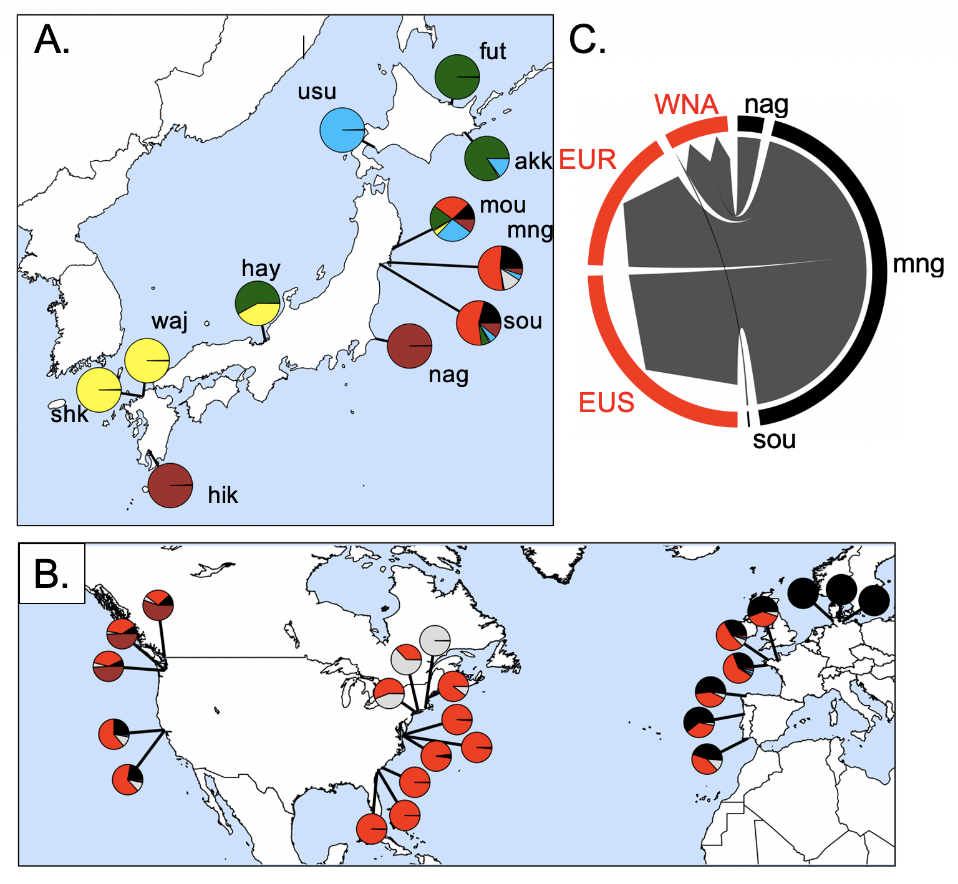
Source of the invasion is northeastern Japan
62,235 SNPs
32 populations
Admixture analysis
Flanagan, Krueger-Hadfield, Murren, Nice, Strand and Sotka (in press) Molecular Ecology

Slide 59
Results (so far)
We can trace genetic history of feral Crassostrea gigas back to native sources
Northern Japan was source for NW North America, southern Europe
Southern Japan source for California and New Zealand
Strange “hybrid” / inbred line / Sea of Japan lineage is found in South America and northern Europe
The environment of native sources predicts local non-native environments.
This suggests either ecological fitting or strain dispersal (or others?)

Slide 60
We note that our approach is to collect feral populations today to infer neutral dispersal patterns that occurred in the past; thus, our interpretations of geographic patterns must keep this limitation in mind. For example, concluding that Pacific Northwest individuals came from northern Japan and southern California from southern Japan may indicate a) the historical record is incorrect or b) the historical record is correct, oysters arrived from all over Japan, but a subset of genotypes created feral populations that survive today.

Slide 61
Argentina | Evangelina Schwindt
Chile | Martin Thiel, Jim Carlton
Denmark | Asa Strand
France | Eric Pante
Ireland | Asa Strand, Judith Kochmann
Japan | Takefumi Yorisue, Masahiro Nakaoka, Mits Kanaya, Masahiro Hori, Gen Kanaya, Ryuta Terada, Hikaru Endo
Korea | Kun-Seop Lee
New Zealand | Richard Taylor
Norway | Asa Strand
USA | Jennifer Ruesink, Hilary Heyford, Danielle Zacherl, Jeff Crooks
Spain | Lucia Couceiro
Sweden | Asa Strand, Judith Kochmann

Slide 62
Colors for the PC

Slide 63
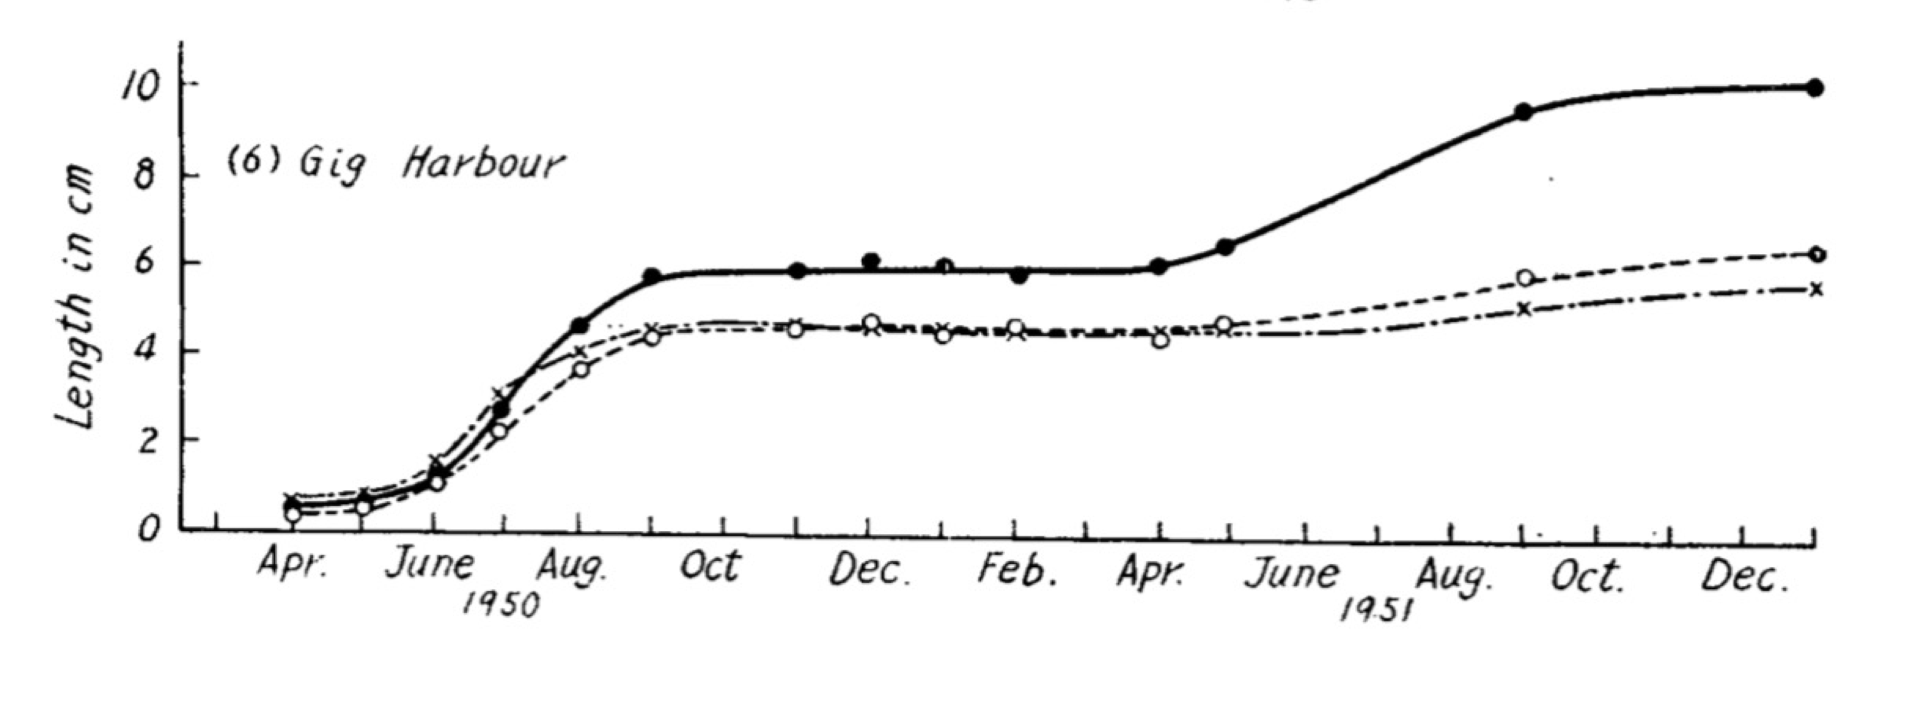
Northern Japan oysters (38% mortality)
Southern Japan oysters (74% mortality)
Northern (44ºN) Japanese oysters had greater fitness in Puget Sound WA (47ºN) relative to Southern (33ºN) Japanese oysters
Northern Japan
Southern Japan

Slide 64
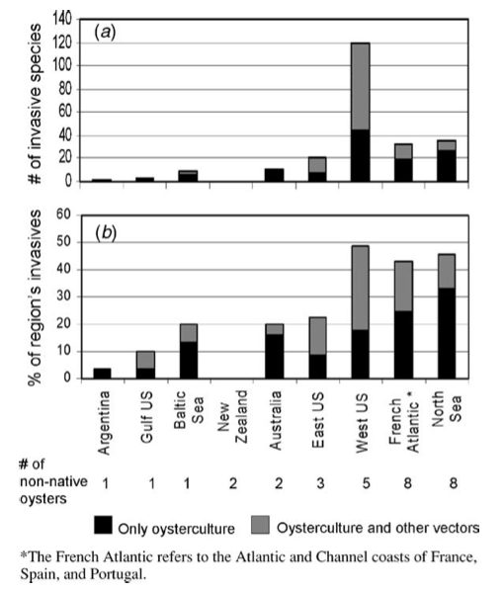
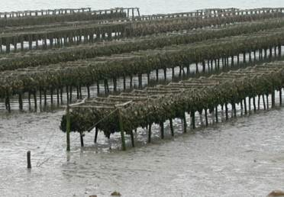
Dozens of species that moved with C. gigas
Ruesink et al. 2005 ARES

Slide 65
Biological invasions are a major driver of ecosystem degradation. The number of invasive alien species is increasing rapidly with no evidence that either the rate of species introduction or the emergence of new invasive species is slowing down. Pyšek et al 2020 Biological Review
One critical piece of the puzzle in the understanding of biological invasions is an understanding of the his- tory of the invasion process, including the geographical pathways followed by the founders of the invading populations. Indeed, the genetic variability of invading populations, in terms of both molecular and quantita- tive traits, depends on the history of their populations of origin and the historical and demographical features of their introduction. Estoup and Guillemaud 2010 ME.

Slide 66
Oyster biologists identified “appropriate” genetic sources via transplant experiments
Imai and Sakai 1961
Hokkaido
Hiroshima
Kumamoto

Slide 67
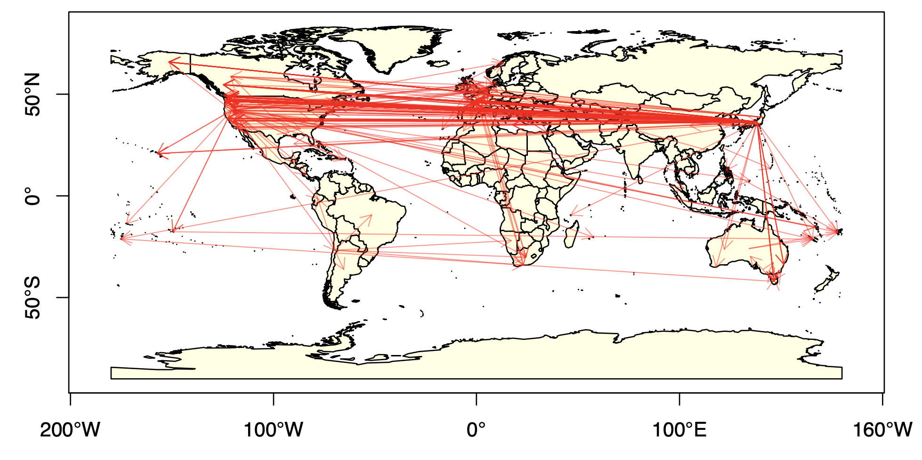
Historical record of Pacific oyster shipments
- Compiled by Laney Pound (CofC)

Slide 68
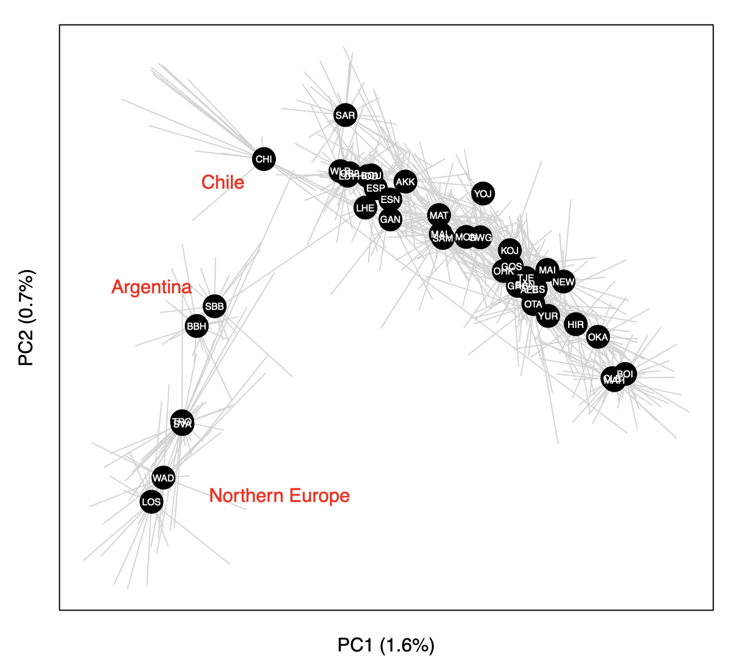
Principal components analysis (PCA) of 726 oysters using 7046 loci

Slide 69

G. vermiculophylla distribution
Introduced: Europe
Introduced: North America
Native

Slide 70
Source of the invasion is northeastern Japan
Annual Sea Surface
Temperature (ºC)
Flanagan, Krueger-Hadfield, Murren, Nice, Strand and Sotka (in press) Molecular Ecology

Slide 71

Mangoku-ura, Japan
May 2015

